Slide 1

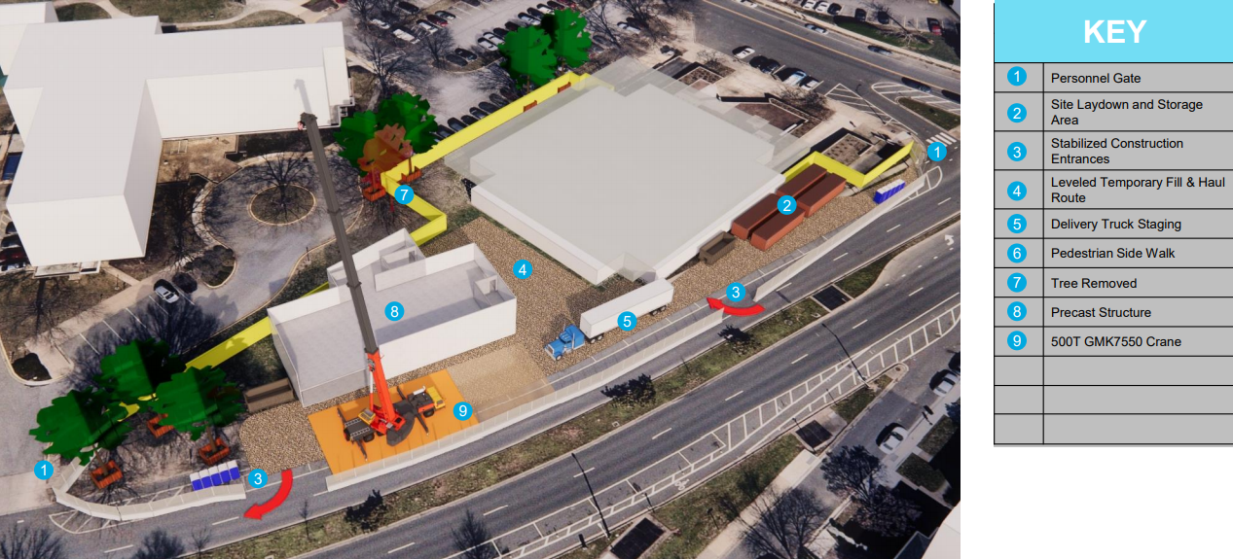


Construction Phase 3: Precast Structures
Fall 2021- Early 2022
During this phase of work, we will construct the new building from the basement to the roof. This will also be completed using pre-cast concrete.
The concrete will be fabricated off-site and installed by crane. During this time, we will utilize “Phase 2 Maintenance of Traffic Plan (MOT)”, which can be referenced on the project website, under “documents”

